Slide 1


React Native quick start

Slide 2

WHY react native

Slide 3

MEET REACT NATIVE
React Native is a JavaScript framework for writing real, natively rendering
mobile applications for iOS and Android.
It’s based on React, but instead of targeting the browser,
it targets mobile platforms.
Notes:
https://www.couponhippo.in/blog/reasons-to-choose-react-native
https://www.safaribooksonline.com/library/view/learning-react-native/9781491929049/ch01.html

Slide 4

WHAT IS REACT NATIVE
Similar to React for the Web, React Native applications are written using a mixture of JavaScript and JSX.
But…
No HTML, JSX components instead
cross-platform: View, Text, Image, Picker
platform specific: TabBarIOS, ToolbarAndroid etc.
No CSS, only CSS-like styles + Flexbox
No DOM API at all
Notes:
https://www.safaribooksonline.com/library/view/learning-react-native/9781491929049/ch01.html

Slide 5
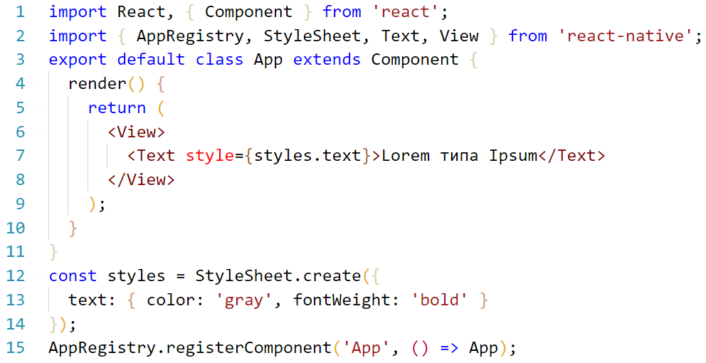
HEY, SHOW ME THE CODE
Notes:
https://facebook.github.io/react-native/docs/style.html

Slide 6

WHAT IS REACT NATIVE
React Native bridges JS calls to the native APIs in Objective-C or Java.
Rendering is performed using real mobile UI components, with look and feel like any mobile application.
Platform features like the phone camera, or the user’s location are accessible through JS interfaces.
As most of the code can be shared between platforms, React Native makes it easy to develop for both Android and iOS simultaneously.
We didn't aim for code sharing between platforms when working on the iOS Ads Manager but expected it could be a nice side effect of using React Native. When the Android Ads Manager was ready to ship, we realized that about 85% of the code was shared between the two apps.
Notes:
https://www.safaribooksonline.com/library/view/learning-react-native/9781491929049/ch01.html
TODO: iterative list

Slide 7

WHAT IS REACT NATIVE
React Native was announced by Facebook in 2015 on the F8 developer conference and in the “Bringing modern web techniques to mobile” blog post.
2013, summer Started as a hackathon project
2014, summer Ads Manager for iOS project start
2014, autumn React Native Android runtime
2015, winter Ads Manager for iOS project release
2015, winter Public technology preview
2015, spring iOS runtime open-sourced
2015, summer Ads Manager for Android release
2015, autumn Android runtime open-sourced
Notes:
https://code.facebook.com/posts/1014532261909640/react-native-bringing-modern-web-techniques-to-mobile

Slide 8
NATIVE VS CROSS-PLATFORM NATIVE
APPROACH
ADVANTAGES
DISADVANTAGES
NATIVE DEVELOPMENT
Best performance
Best user experience
Most conformance to UI guide lines on each platform
Easily customizable
Longer timeline and effort for development
In post-delivery support one developer required for each platform
No code reuse
CROSS-PLATFORM NATIVE
Shared business logic code
Same language used for all platforms
Faster release/bug-fix cycle due to OTA updates
Single developer can support both platforms on post-delivery phase
Better development experience
Potential performance problems doing “heavy lifting”
Effort to create plugins if some native API doesn’t exist
Single thread due to JavaScript
Notes:
Native Script is Angular based and proposed the “use our components” approach instead of “write your own components”

Slide 9
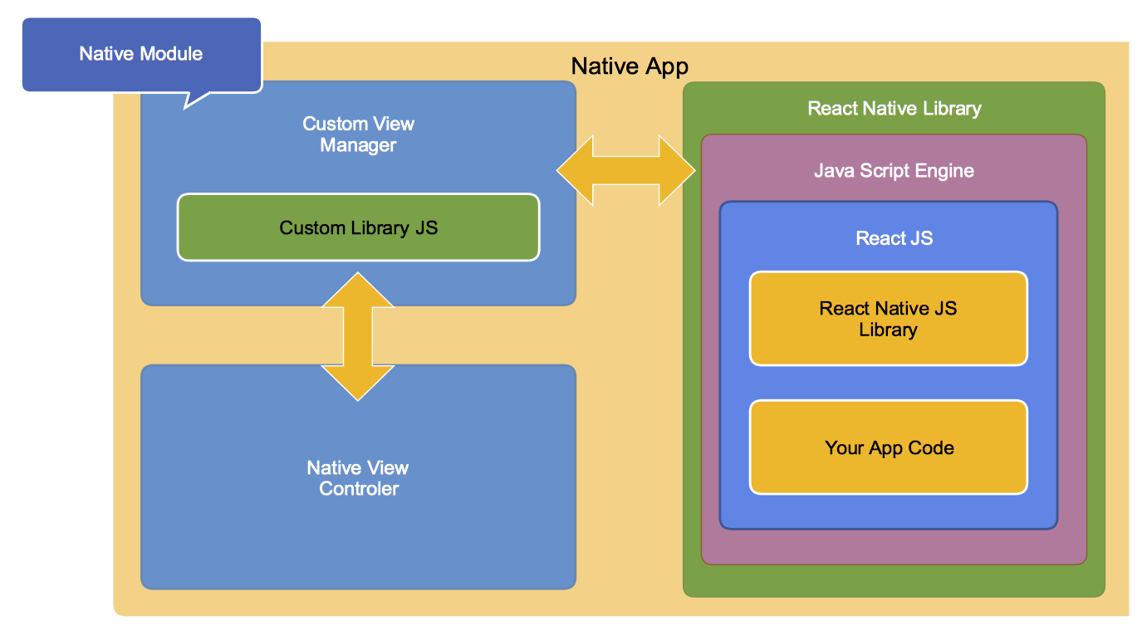
REACT NATIVE HIGH-LEVEL ARCHITECTURE

Slide 10






SOME POPULAR APPS BUILT ON REACT NATIVE
Facebook
iOS · Android
Instagram
iOS · Android
EPAM Events Mobi
iOS · Android
Skype
iOS · Android
Tesla
iOS · Android
Baidu Mobile
iOS · Android
Notes:
https://facebook.github.io/react-native/showcase.html

Slide 11
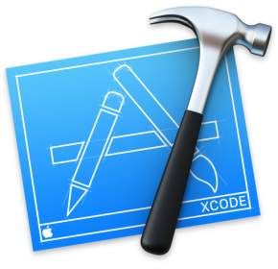



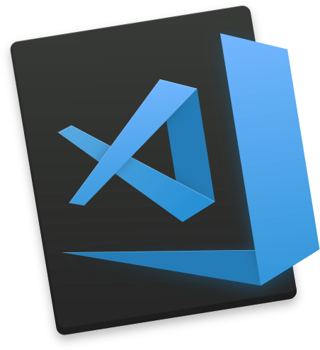






MAIN TOOLSET
IOS (Swift, Objective-C)
Android (Java, Kotlin)
Hybrid (React Native)
Notes:
TODO: Update layout, rethink this slide – split dev tools and recommendation

Slide 12


GENERAL RECOMMENDATION
You may decide to use create-react-native-app or Expo to avoid dealing with native languages, SDKs and build tools. The price is limitation in number of available native modules.
Just start with your favorite editor
add
(recommended) or

Slide 13
CREATE-REACT-NATIVE-APP
Philosophy:
Minimal time to "Hello World“
Develop on your device
One Build Tool
no Xcode, Android Studio, NDKs, ENV_VARS
No Lock-In
"eject" to own build setup and write custom native code or modify how app is built
Limitations:
Pure JavaScript
No dependencies which rely on custom native code
“made by react community”
Notes:
https://github.com/react-community/create-react-native-app

